Slide 1
0.7% w/w (1% in theory) Nano TOF SIMS raw maps and distributions
For Figure 4 and Figure S10-S12 defg
10 ppm c-Se-PS-MNPs
1 ppm c-Se-PS-MNPs
0.1 ppm C-Se-PS-MNPs
1 ppm Se-PS-NPs
0.1 ppm Se-PS-NPs
All maps brightness and contrast were adjusted to enhance the brightest spots using the Picture format → Corrections option on Power Point

Slide 2
10 ppm c-Se-PS-MNPs

Slide 3
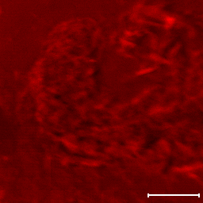
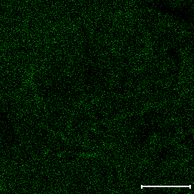
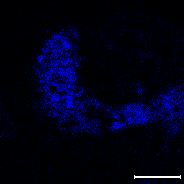
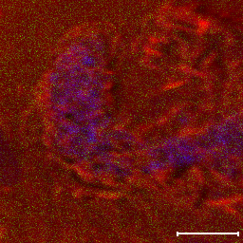
positive- (1%w/w) -10 (ppm) -B-400 um
+ Ions, xxx µm analysis area (xxx µm scale bar)
Total_Ion (256x256)
Cts: 41150639; Max: 1496; Scale: 100µm
Se - 79.92 (256x256)
Cts: 41419; Max: 7; Scale: 100µm
C₇H₇ - 91.03 (256x256)
Cts: 77933; Max: 19; Scale: 100µm
OVERLAY
Enter Slide Comments Here

Slide 4
positive- (1%w/w) -10 (ppm) -B-400 um
7
*25 june 25-spot 1-1-10-400 um-001~pb1.tdc + Ions 400µm 41150639 cts
Counts/1E6
6
5
4
41
95
3
23
104
123
2
27
79
86
97
120
157
1
0
0
50
100
150
Mass [m/z]
1.5
*25 june 25-spot 1-1-10-400 um-001~pb1.tdc + Ions 400µm 41150639 cts
Counts/1E3
1.0
80.0453
0.5
0.0
79.80
79.85
79.90
79.95
80.00
Mass [m/z]
5
*25 june 25-spot 1-1-10-400 um-001~pb1.tdc + Ions 400µm 41150639 cts
Counts/1E3
4
3
90.93
90.98
91.94
2
91.15
1
0
90.0
90.5
91.0
91.5
Mass [m/z]
Enter Slide Comments Here

Slide 5
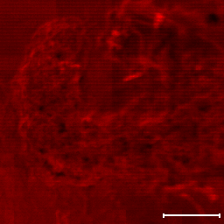
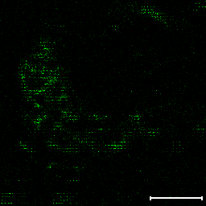
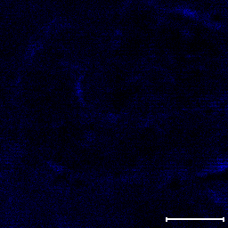
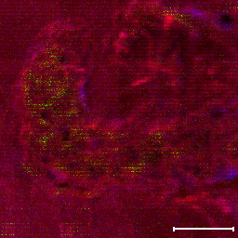
Negative- (1%w/w) -10 (ppm) -B-400 um
+ Ions, xxx µm analysis area (xxx µm scale bar)
Total_Ion (256x256)
Cts: 92675861; Max: 3701; Scale: 100µm
Se - 79.92 (256x256)
Cts: 13327; Max: 9; Scale: 100µm
C₇H₇ - 91.03 (256x256)
Cts: 147333; Max: 20; Scale: 100µm
OVERLAY
Enter Slide Comments Here

Slide 6
Negative- (1%w/w) -10 (ppm) -B-400 um
8
*25 june 25-spot 1-1-10-negative-400 um-002~pb1.tdc - Ions 400µm 92675862 cts
Counts/1E6
6
13
4
16
26
42
69
79
2
45
49
59
63
71
0
0
50
100
150
Mass [m/z]
1.4
*25 june 25-spot 1-1-10-negative-400 um-002~pb1.tdc - Ions 400µm 92675862 cts
Counts/1E4
1.2
1.0
80.0205
80.0274
0.8
0.6
0.4
0.2
0.0
79.80
79.85
79.90
79.95
80.00
Mass [m/z]
7
*25 june 25-spot 1-1-10-negative-400 um-002~pb2.ROI1.tdc - Ions 400µm 21147445 cts
Counts/1E3
6
5
4
3
90.02
91.98
2
1
0
90.0
90.5
91.0
91.5
Mass [m/z]

Slide 7
1 ppm c-Se-PS-MNPs

Slide 8
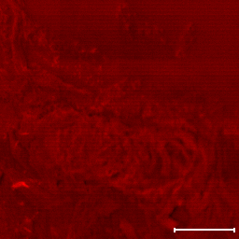
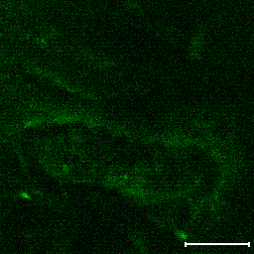
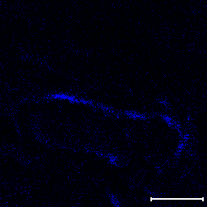
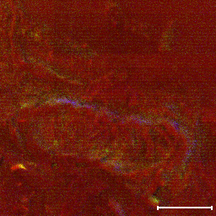
2 Sep 25- 1-1- C-20 um-400 um-positive-second time
Total_Ion (256x256)
Cts: 80062701; Max: 2857; Scale: 100µm
79.930 (256x256)
Cts: 195808; Max: 25; Scale: 100µm
C₂H₃O₄ - 91.02 (256x256)
Cts: 40948; Max: 13; Scale: 100µm
OVERLAY
Enter Slide Comments Here

Slide 9
2 sep 25-1-1-C-20um- positive-400 um
7
*2 Sep 25-1-1-C-20 um-400-positive-003~pb1.tdc + Ions 400µm 35279860 cts
Counts/1E6
6
5
95
4
3
78
104
2
23
55
86
123
157
213
1
69
141
0
0
200
400
600
800
Mass [m/z]
1.2
*2 Sep 25-1-1-C-20 um-400-positive-003~pb1.tdc + Ions 400µm 35279860 cts
Counts/1E3
1.0
0.8
79.9841
0.6
0.4
0.2
0.0
79.5
79.6
79.7
79.8
79.9
Mass [m/z]
1.0
*2 Sep 25-1-1-C-20 um-400-positive-003~pb1.tdc + Ions 400µm 35279860 cts
Counts/1E4
0.8
0.6
0.4
90.92
91.93
0.2
0.0
90.0
90.5
91.0
91.5
Mass [m/z]
Enter Slide Comments Here

Slide 10
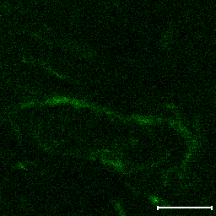
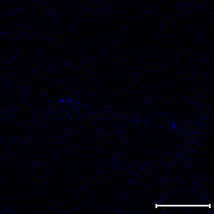
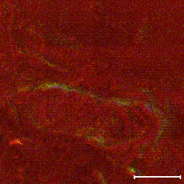
2 Sep 25- 1-1- C-20 um-400 um-negative-second time
+ Ions, xxx µm analysis area (xxx µm scale bar)
Total_Ion (256x256)
Cts: 80062701; Max: 2857; Scale: 100µm
Se - 79.92 (256x256)
Cts: 80319; Max: 15; Scale: 100µm
91.041 (256x256)
Cts: 9857; Max: 4; Scale: 100µm
OVERLAY
Enter Slide Comments Here

Slide 11
2 Sep 25- 1-1-C-20 um-400 um-nagative-002-good
1.0
*2 Sep 25-1-1-C-20 um-100-negative-006.tdc - Ions 400µm 80062701 cts
Counts/1E7
0.8
1
0.6
13
16
25
42
0.4
12
17
26
41
59
63
79
0.2
0.0
0
20
40
60
80
Mass [m/z]
8
*2 Sep 25-1-1-C-20 um-100-negative-006.tdc - Ions 400µm 80062701 cts
Counts/1E3
6
4
2
0
79.80
79.85
79.90
79.95
Mass [m/z]
*2 Sep 25-1-1-C-20 um-100-negative-006.tdc - Ions 400µm 80062701 cts
Counts/1E4
1.5
1.0
91.92
0.5
0.0
90.0
90.5
91.0
91.5
Mass [m/z]
Enter Slide Comments Here

Slide 12
0.1 ppm c-Se-PS-MNPs

Slide 13
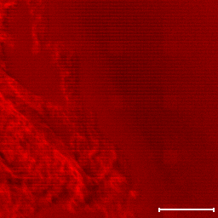
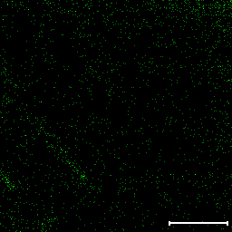
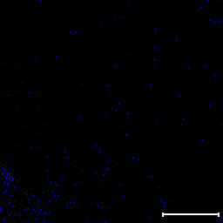
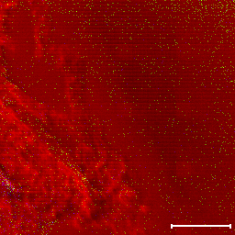
3 Sep 25- 0.1-1C-20um-400 um-positive
+ Ions, xxx µm analysis area (xxx µm scale bar)
Total_Ion (256x256)
Cts: 32591190; Max: 921; Scale: 100µm
Se - 79.92 (256x256)
Cts: 2022; Max: 2; Scale: 100µm
91.041 (256x256)
Cts: 429; Max: 2; Scale: 100µm
OVERLAY
Enter Slide Comments Here

Slide 14
3 Sep 25- 0.1-1C-20um-400 um-positive
6
*3 Sep 25-1-0.1-C-20 um-400-positive-after puttering 30 se-005.tdc + Ions 400µm 32591190 cts
Counts/1E6
5
4
41
3
23
29
79
95
2
28
40
78
97
1
1
24
0
0
20
40
60
80
Mass [m/z]
2.5
*3 Sep 25-1-0.1-C-20 um-400-positive-after puttering 30 se-005.tdc + Ions 400µm 32591190 cts
Counts/1E3
2.0
1.5
79.9767
1.0
0.5
0.0
79.80
79.85
79.90
79.95
Mass [m/z]
1.6
*3 Sep 25-1-0.1-C-20 um-400-positive-after puttering 30 se-005.tdc + Ions 400µm 32591190 cts
Counts/1E3
1.4
90.94
91.07
1.2
1.0
91.05
0.8
0.6
91.01
0.4
0.2
0.0
90.0
90.5
91.0
91.5
Mass [m/z]
Enter Slide Comments Here

Slide 15
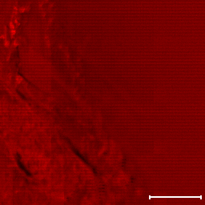
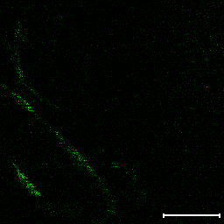
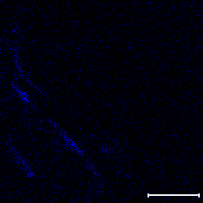
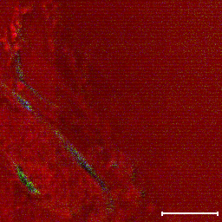
3 Sep 25- 1-0.1- C-20 um-400 um-negative-002-good
+ Ions, xxx µm analysis area (xxx µm scale bar)
Total_Ion (256x256)
Cts: 95329110; Max: 3115; Scale: 100µm
Se - 79.96 (256x256)
Cts: 21119; Max: 8; Scale: 100µm
91.041 (256x256)
Cts: 11872; Max: 6; Scale: 100µm
OVERLAY
Enter Slide Comments Here

Slide 16
3 sept-0.1-1 -C 20 um-after sputtering 30 s-400 um-negative-009
*3 Sep 25-1-0.1-C-20 um-400-negative-after puttering 30 se-003.tdc - Ions 400µm 81286519 cts
Counts/1E6
6
1
12
16
26
5
13
17
25
42
4
50
3
24
41
49
2
1
0
0
20
40
60
80
Mass [m/z]
700
*3 Sep 25-1-0.1-C-20 um-400-negative-after puttering 30 se-003.tdc - Ions 400µm 81286519 cts
600
Counts
500
400
300
200
100
0
79.80
79.85
79.90
79.95
Mass [m/z]
2.5
*3 Sep 25-1-0.1-C-20 um-400-negative-after puttering 30 se-003.tdc - Ions 400µm 81286519 cts
Counts/1E4
2.0
91.87
1.5
91.86
1.0
0.5
0.0
90.0
90.5
91.0
91.5
Mass [m/z]
Enter Slide Comments Here

Slide 17
1 ppm Se-PS-NPs

Slide 18
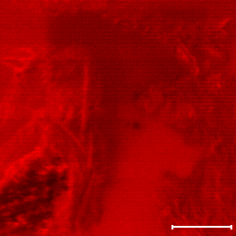
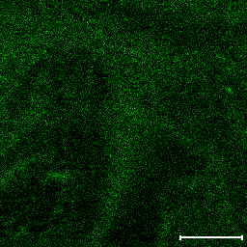
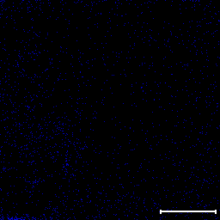
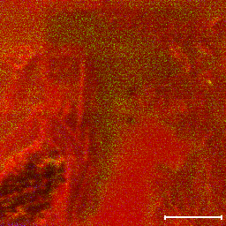
2 sep 25-1-1- 400 um-positive-
+ Ions, xxx µm analysis area (xxx µm scale bar)
Total_Ion (256x256)
Cts: 36071897; Max: 907; Scale: 100µm
Se - 79.91 (256x256)
Cts: 92648; Max: 9; Scale: 100µm
91.041 (256x256)
Cts: 1916; Max: 3; Scale: 100µm
OVERLAY
Enter Slide Comments Here

Slide 19
2 Sep 25-sample (1-1)-400um-poitive
8
*2 Sep 25- 1-1- NPs-400 um-positive-005.tdc + Ions 400µm 36071896 cts
Counts/1E6
6
4
23
41
79
95
2
24
28
40
78
94
97
0
0
20
40
60
80
Mass [m/z]
3.0
*2 Sep 25- 1-1- NPs-400 um-positive-005.tdc + Ions 400µm 36071896 cts
Counts/1E3
2.5
2.0
1.5
1.0
0.5
0.0
79.80
79.85
79.90
79.95
Mass [m/z]
2.0
*2 Sep 25- 1-1- NPs-400 um-positive-005.tdc + Ions 400µm 36071896 cts
Counts/1E3
90.96
91.09
1.5
1.0
91.08
0.5
0.0
90.0
90.5
91.0
91.5
Mass [m/z]
Enter Slide Comments Here

Slide 20
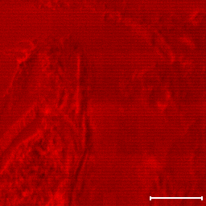
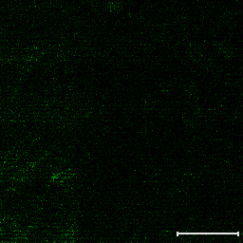
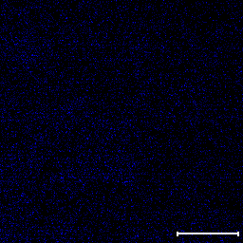
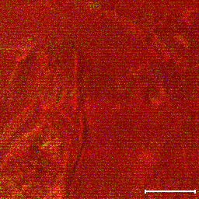
2 sep 25-1-1-negative-400 um
+ Ions, xxx µm analysis area (xxx µm scale bar)
Total_Ion (256x256)
Cts: 47655321; Max: 1193; Scale: 100µm
Se - 79.97 (256x256)
Cts: 69473; Max: 9; Scale: 100µm
91.041 (256x256)
Cts: 13011; Max: 5; Scale: 100µm
OVERLAY
Enter Slide Comments Here

Slide 21
2 sep 25-1-1 negative-400 um
6
*2 Sep 25- 1-1- NPs-400 um-negative-005.tdc - Ions 400µm 47655321 cts
Counts/1E6
5
1
4
17
26
3
13
16
25
41
43
79
2
12
59
71
1
0
0
20
40
60
80
Mass [m/z]
6
*2 Sep 25- 1-1- NPs-400 um-negative-005.tdc - Ions 400µm 47655321 cts
Counts/1E4
5
4
3
2
1
0
78.80
78.85
78.90
78.95
Mass [m/z]
4
*2 Sep 25- 1-1- NPs-400 um-negative-005.tdc - Ions 400µm 47655321 cts
Counts/1E3
3
91.11
2
91.97
90.02
90.20
91.09
1
90.23
91.13
0
90.0
90.5
91.0
91.5
Mass [m/z]
Enter Slide Comments Here

Slide 22
0.1 ppm Se-PS-NPs

Slide 23
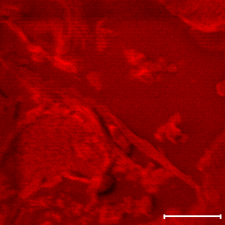
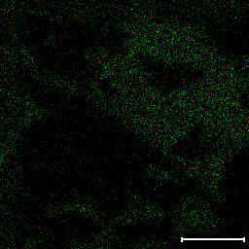
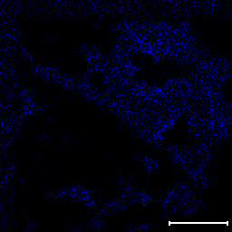
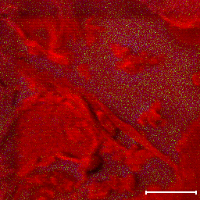
2 Sep 25- 1-0.1- NPs-400 um-postive-002-good
+ Ions, xxx µm analysis area (xxx µm scale bar)
Total_Ion (256x256)
Cts: 20735271; Max: 575; Scale: 100µm
Se - 79.97 (256x256)
Cts: 11029; Max: 4; Scale: 100µm
91.055 (256x256)
Cts: 38217; Max: 11; Scale: 100µm
OVERLAY
Enter Slide Comments Here

Slide 24
2 Sep 25- 1-0.1- NPs-400 um-postive-002-good
3.0
*2 Sep 25- 1-0.1- NPs-400 um-postive-002.tdc + Ions 400µm 20735271 cts
Counts/1E6
2.5
23
2.0
1.5
28
41
1.0
27
29
43
55
79
95
97
0.5
81
0.0
0
20
40
60
80
Mass [m/z]
400
*2 Sep 25- 1-0.1- NPs-400 um-postive-002.tdc + Ions 400µm 20735271 cts
Counts
300
200
100
0
79.80
79.85
79.90
79.95
Mass [m/z]
2.0
*2 Sep 25- 1-0.1- NPs-400 um-postive-002.tdc + Ions 400µm 20735271 cts
Counts/1E3
90.04
91.92
1.5
1.0
90.03
90.93
90.97
91.93
0.5
0.0
90.0
90.5
91.0
91.5
Mass [m/z]
Enter Slide Comments Here

Slide 25
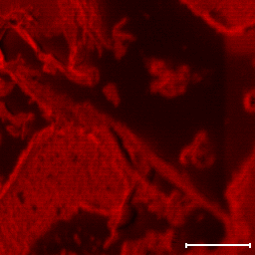
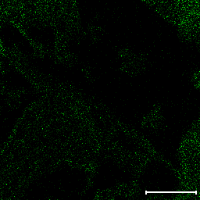
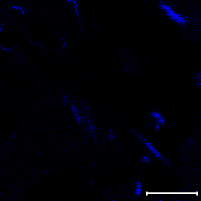
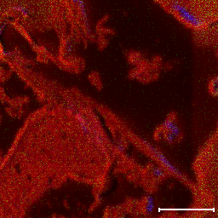
2 Sep 25- 1-0.1- NPs-400 um-negative-
+ Ions, xxx µm analysis area (xxx µm scale bar)
Total_Ion (256x256)
Cts: 43763782; Max: 1915; Scale: 100µm
79.930 (256x256)
Cts: 13478; Max: 6; Scale: 100µm
91.055 (256x256)
Cts: 39615; Max: 24; Scale: 100µm
OVERLAY
Enter Slide Comments Here

Slide 26
2 Sep 25- 1-0.1- NPs-400 um-nagative-002-good
6
*2 Sep 25- 1-0.1- NPs-400 um-negative-after 20 s sputtering-002.tdc - Ions 400µm 43763782 cts
Counts/1E6
5
26
4
1
12
24
3
17
25
2
13
42
50
60
91
1
0
0
20
40
60
80
Mass [m/z]
35
*2 Sep 25- 1-0.1- NPs-400 um-negative-after 20 s sputtering-002.tdc - Ions 400µm 43763782 cts
30
Counts
25
20
15
10
5
0
79.80
79.85
79.90
79.95
Mass [m/z]
4
*2 Sep 25- 1-0.1- NPs-400 um-negative-after 20 s sputtering-002.tdc - Ions 400µm 43763782 cts
Counts/1E4
3
2
90.09
1
0
90.0
90.5
91.0
91.5
Mass [m/z]
Enter Slide Comments Here

